Slide 1


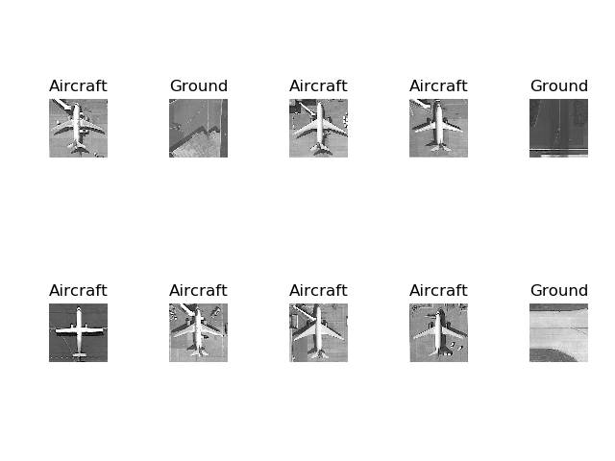
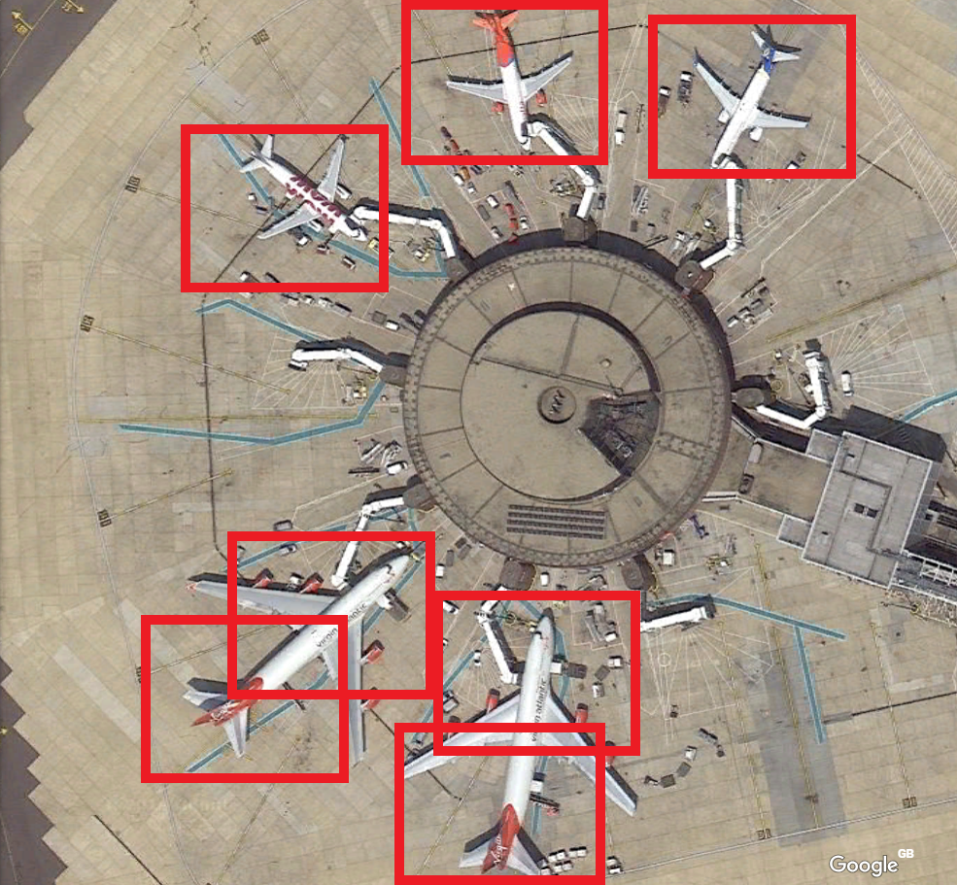
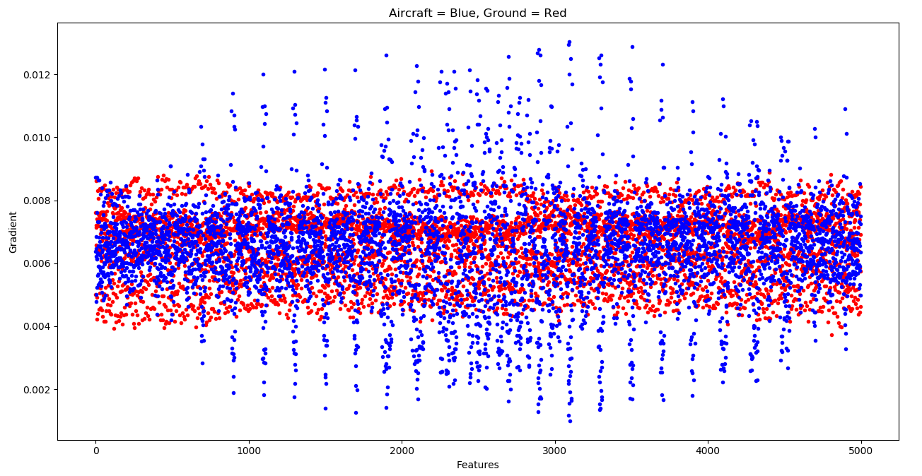
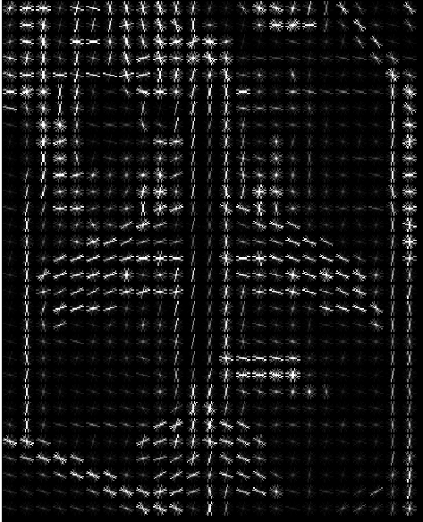
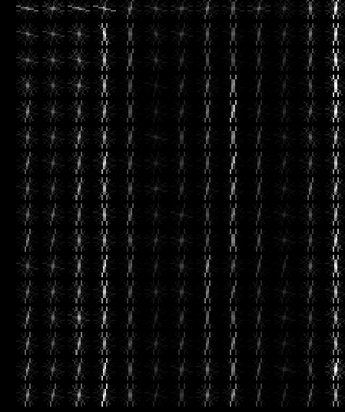
Identifying Aircraft from Above
Kai Roper-Blackman supervised by Sebastian Halder
Objectives:
To differentiate between Aircraft and Ground images
To identify aircraft of various sizes and orientations in a larger image such as an airport and show their positions to the user
Figure 1: Standalone images after classification
Methods:
Pre-processing: Histogram of Oriented Gradients (figure 4 and 5) used to obtain feature descriptor from images. Feature descriptor describes image mathematically to Machine learning model.
Support Vector Machine takes training and test data in the form of feature descriptors. Model evaluates the test images after training is complete and returns prediction with associated probabilities.
In large image search (figure 2), red boxes are place on areas with highest probability of aircraft
Figure 3: Visual representation of two feature descriptors. Red = Ground, blue = Aircraft
Figure 4 & 5 (left): Histogram of Oriented gradients on aircraft and ground image depicting direction of colour gradient
Figure 2: Search results from large image
Results:
The large red squares in figure 2 indicate the system predicts an is in that particular location.
10 fold cross validation score of standalone images reached 100%
Ground images have a low variance in gradient whereas Aircraft have a high variance.
Detection of aircraft in larger images results in accuracy of 50%-60%

